Slide 1
Deep LEARNING
Inspiration
Notes:
-

Slide 2
Summary
What is a neural network
Trick to make it better
State of the art techniques
Applications – text, voice, image

Slide 3
Why Deep Learning is important
In 2012 Imagenet reached a new threshold : <5% error rate on image recognition (better than human)
Mask r-cnn https://github.com/facebookresearch/deepmask
Style transfer : CNTK tuto 205 https://github.com/Microsoft/CNTK/tutorials

Slide 4
Current limit of R compared to Python : Deep Learning
Until very recently, R community was very limited for Deep Learning development
Thank to Rstudio, one can now use 2 major Deep Learning Frameworks : Keras & TensorFlow

Slide 5
A Neuron
Neuron ~ Logistic regression

Slide 6
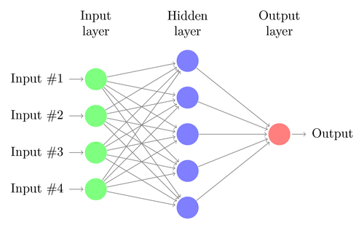
Dense Layer – fully connected

Slide 7
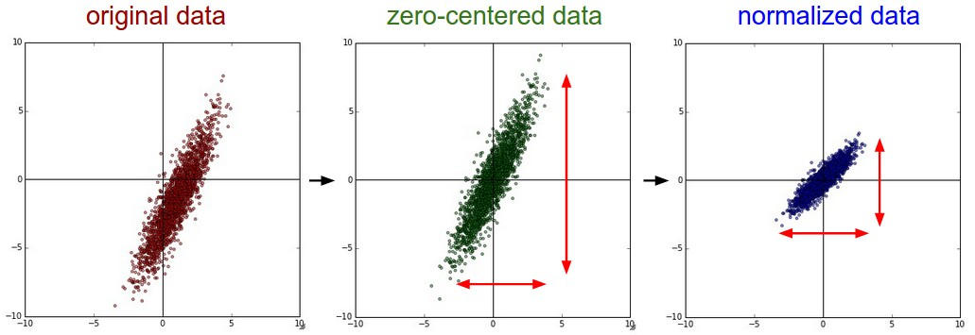
Data preprocessing
Credits : http://cs231n.github.io/neural-networks-2/#datapre

Slide 8
Activation – Bottleneck

Slide 9
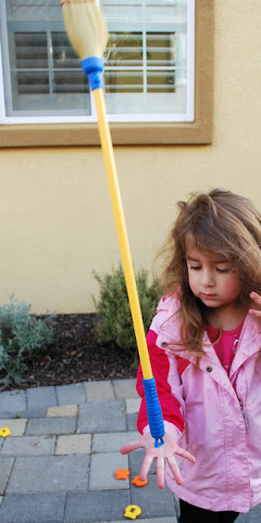

Initialization of weights (beta of each neuron)
Credits : http://cs231n.github.io/neural-networks-2/#init
Example of Unstable Pendulum
Heuristic
Initialize with « small » random number
« With proper data normalization it is reasonable to assume that approximately half of the weights will be positive and half of them will be negative »
« It’s not necessarily the case that smaller numbers will work strictly better, Neural Network layer that has very small weights will during backpropagation compute very small gradients on its data »
See also Vanishing Gradient Problem
Initialize all weights to zero
😆
Batch Normalization
$$w=\left({\begin{aligned}0 \\ 0 \\ .\end{aligned} \atop \begin{aligned} \\ . \\ . \\ . \\ 0\end{aligned}}\right)\underset{⇒}{During BackProp}\frac{∂Error}{∂w_{i_{1},j_{1}}}=\frac{∂Error}{∂w_{i_{2},j_{2}}}$$
« Batch Normalization alleviates a lot of headaches with properly initializing neural networks […] In practice networks that use Batch Normalization are significantly more robust to bad initialization. »
https://www.messforless.net/outdoor-fun-5-games-to-play-with-broom/

Slide 10
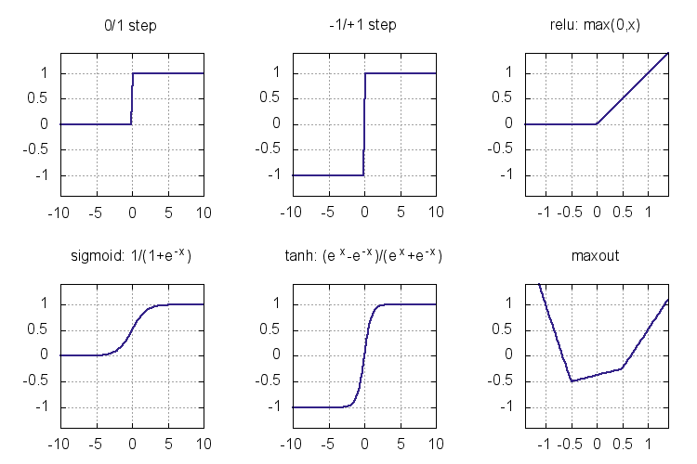
Activation functions
Credits for the image http://knet.readthedocs.io/en/latest/mlp.html
More explanation https://www.quora.com/Why-do-we-not-use-a-differentiable-approximation-of-ReLUs

Slide 11
Activation functions
Credits for the image http://knet.readthedocs.io/en/latest/mlp.html
More explanation https://www.quora.com/Why-do-we-not-use-a-differentiable-approximation-of-ReLUs
Canonical choice : inverse of Logit function

Slide 12
Activation functions
Credits for the image http://knet.readthedocs.io/en/latest/mlp.html
More explanation https://www.quora.com/Why-do-we-not-use-a-differentiable-approximation-of-ReLUs
Rectified Linear Unit :
Faster computation
Canonical choice : inverse of Logit function

Slide 13
Activation functions
Credits for the image http://knet.readthedocs.io/en/latest/mlp.html
More explanation https://www.quora.com/Why-do-we-not-use-a-differentiable-approximation-of-ReLUs
Sufficient to fit any non linearity
https://en.wikipedia.org/wiki/Universal_approximation_theorem

Slide 14
A word on feedforward vs back propagation

Slide 15
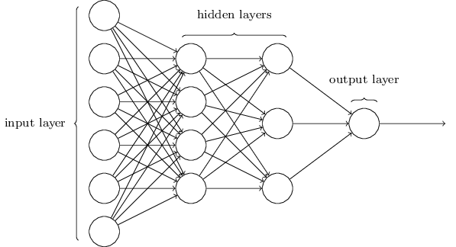
FeedForward & Back Propagation
Feed Forward
Back Prop

Slide 16
A word on SGD & minibatch

Slide 17
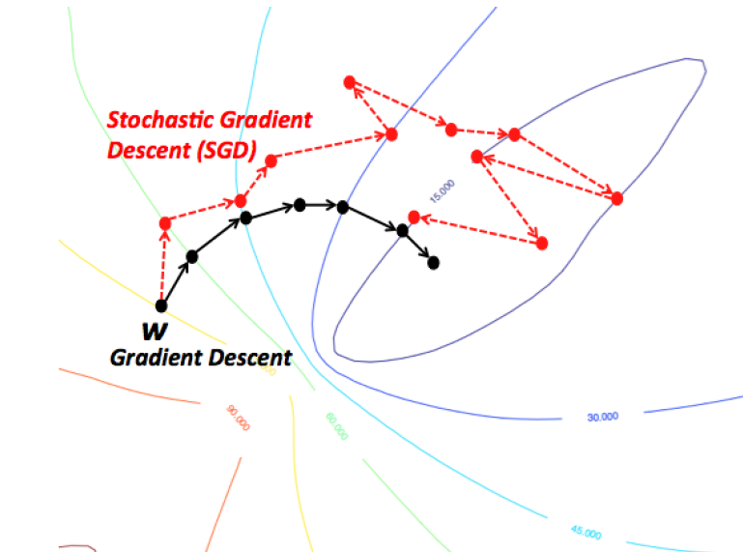
SGD

Slide 18
A word on Regularization for Deep Learning http://egrcc.github.io/docs/dl/deeplearningbook-regularization.pdf
Srivastava et al (2014) showed that dropout is more effective than other standard computationally inexpensive regularizers, such as weight decay, filter norm constraints and sparse activity regularization.
Dropout may also be combined with other forms of regularization to yield a further improvement.

Slide 19
A word on data augmentation, Upsampling/Downsampling, Gaussian Noise
For images : modifiy contrasts, brightness, resolution, smooth the image…
For sound or text : w/ wo punctuation, lower/uppercase... Small deviations

Slide 20
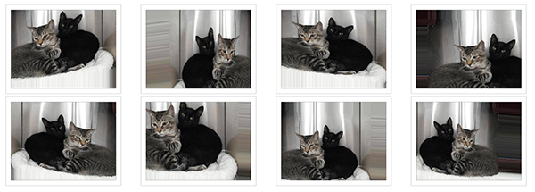
Data Augmentation for images

Slide 21
Batch Normalization
Training Deep Neural Networks is complicated by the fact that the distribution of each layer's inputs changes during training.
This comes from the non-linearity of the activation function. They called this effect « internal covariate shift »
Advice when using Batch Norm :
Don’t put it between input and 1st layer, it’s slower, maybe because the data is more heterogeneous, it takes more time to normalize ?

Slide 22
State of the art of Deep Learning

Slide 23
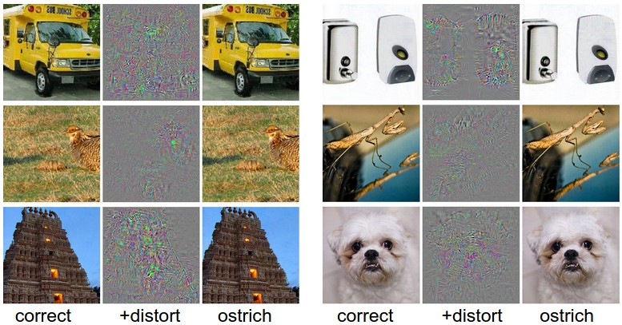
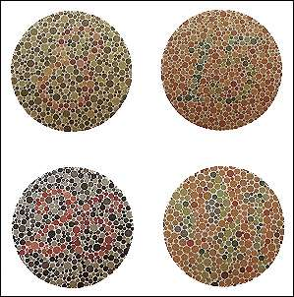
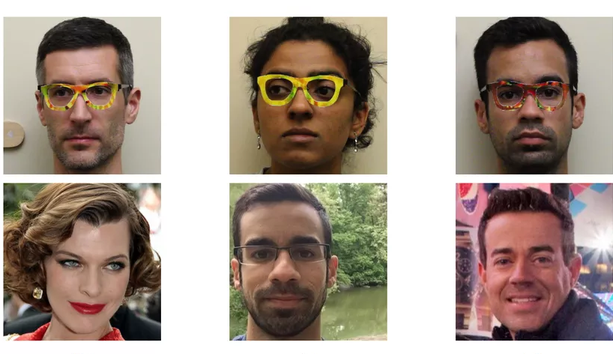
Limits of current AI – Adversarial Machine Learning
Fooling CNN
Color blind analogy
By introducing changes that are invisible to human, the image recognition model is fooled. See Intriguing properties of neural networks by Szegedy et al. 2013
Because Deep Learning models use linear functions to build up the architecture (Breaking Convnets)
« Creating fooling images: “What happens to the score of (whatever class you want) when I wiggle this pixel?” »
See also.
Some critics say :
« A real intelligence doesn’t break when you slightly change the problem »
Deep Convolutional Neural Networks don’t see the world, the way we see it.
Input
Input
Input
Is AI riding a One-Trick Pony ?
Fake glasses to fool facial recognition
Backprop, in the words of Jon Cohen, a computational psychologist at Princeton, is « what all of deep learning is based on—literally everything. »
Read the article by James Somers
Output
Output
Output

Slide 24
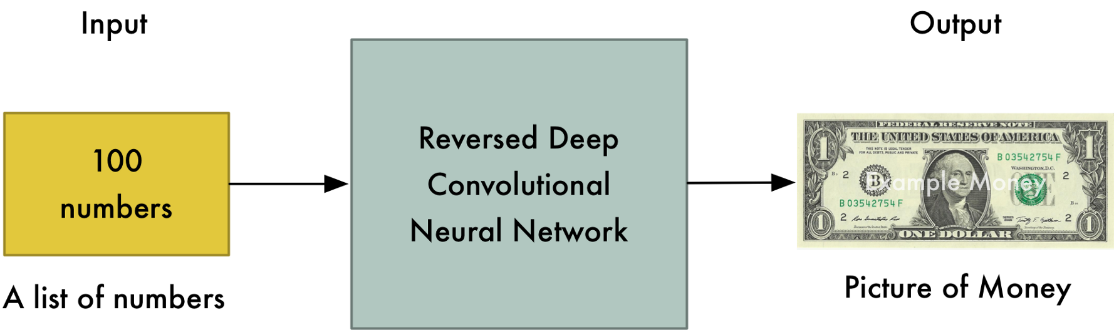
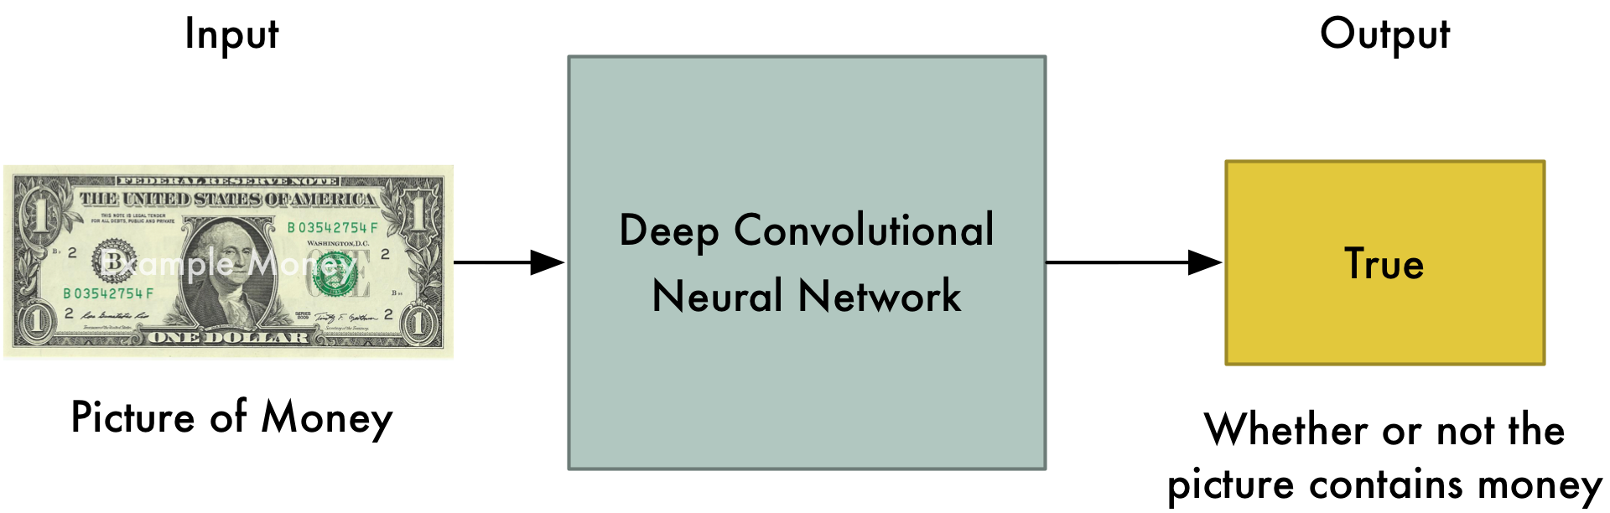
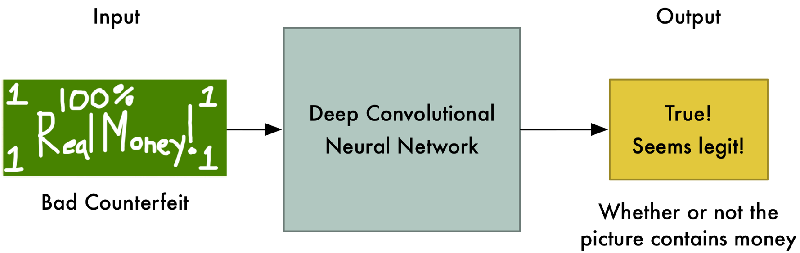
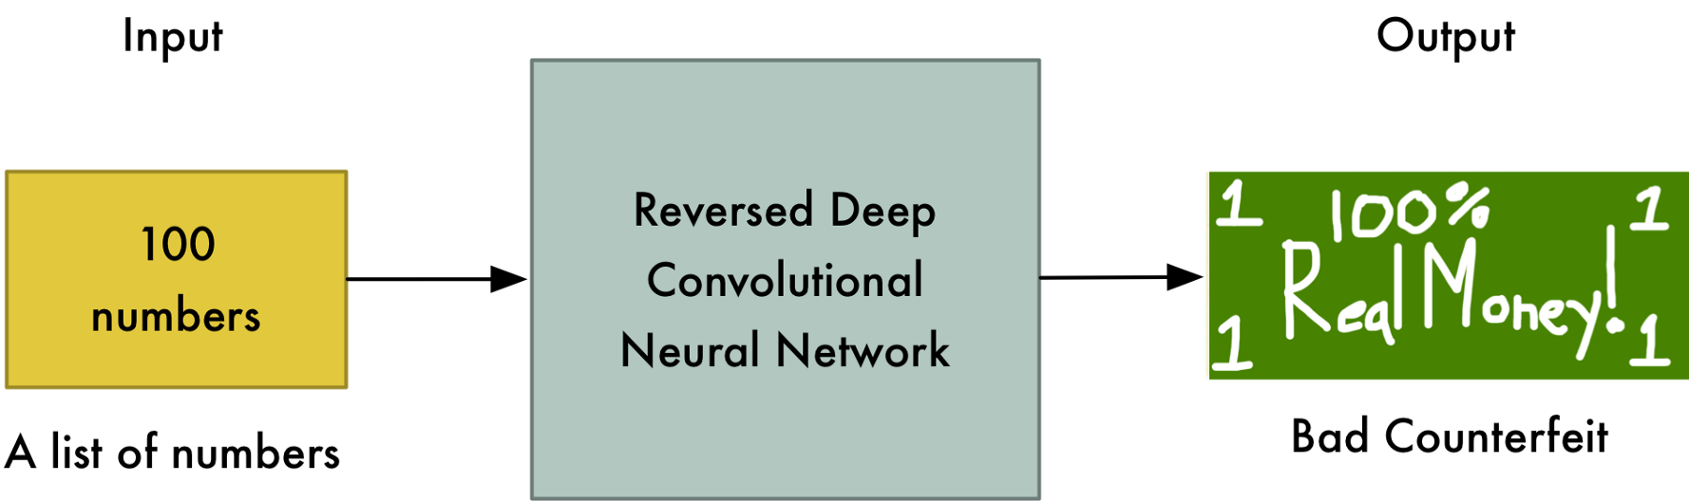

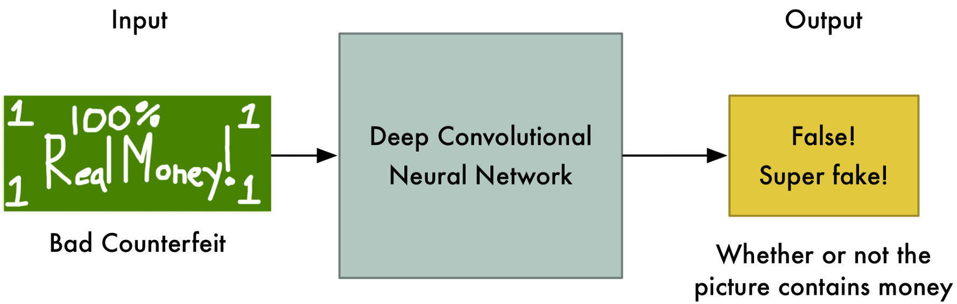
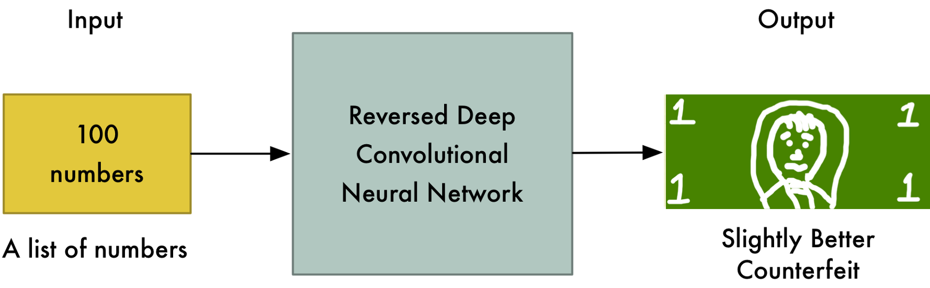
DCGAN approach
The Generator Network
The Discriminator Network
Heuristic
The Generator makes the first (terrible) fake dollar
The Discriminator thinks the dollar is real!
TRUE
FALSE
Next iteration
https://medium.com/@ageitgey/abusing-generative-adversarial-networks-to-make-8-bit-pixel-art-e45d9b96cee7

Slide 25
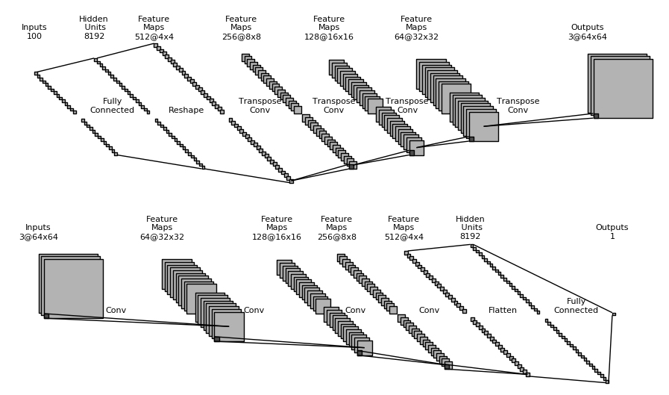
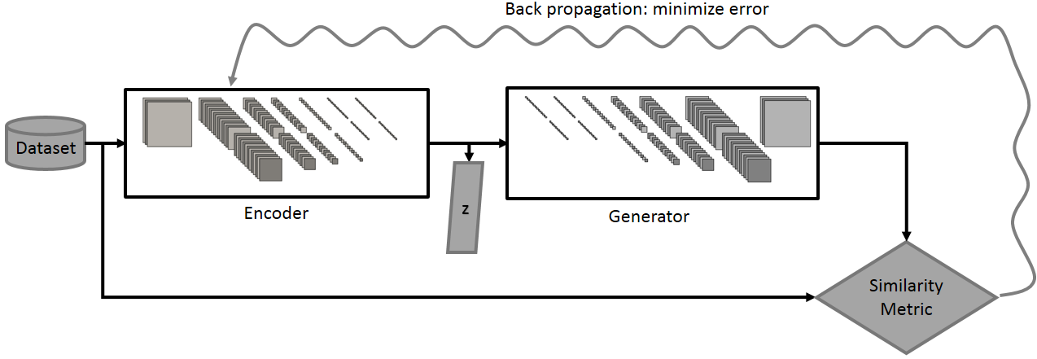
DCGAN approach – Graph representation (+Embedding principle)
The Generator Network
The Discriminator Network
Nice graph of CNN representing the Generator and Disciminator
https://devblogs.nvidia.com/parallelforall/photo-editing-generative-adversarial-networks-2/
https://www.theverge.com/2017/4/12/15271874/ai-adversarial-images-fooling-attacks-artificial-intelligence
GAN Auto-encoder/ image embedding
https://arxiv.org/abs/1702.01983v1

Slide 26
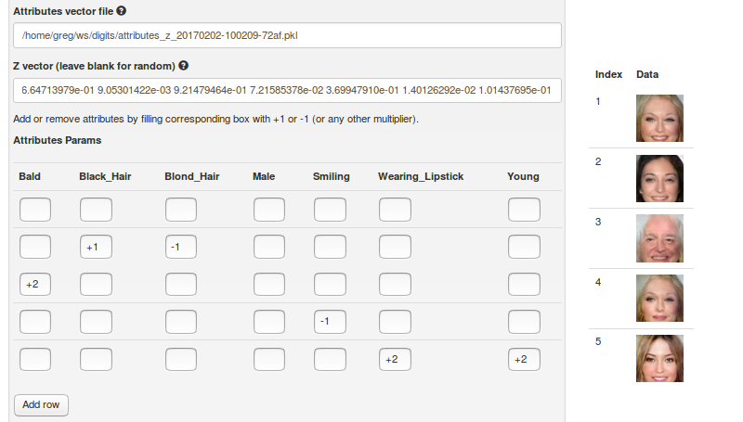
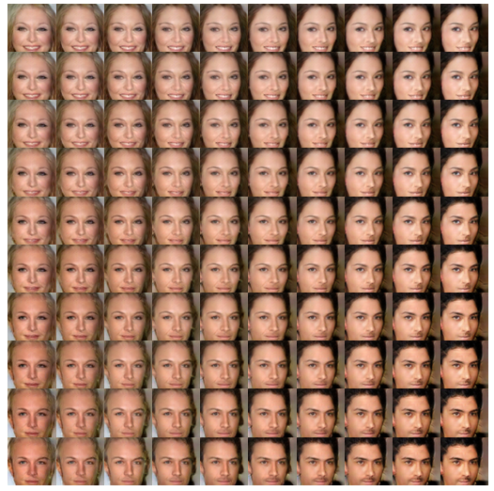
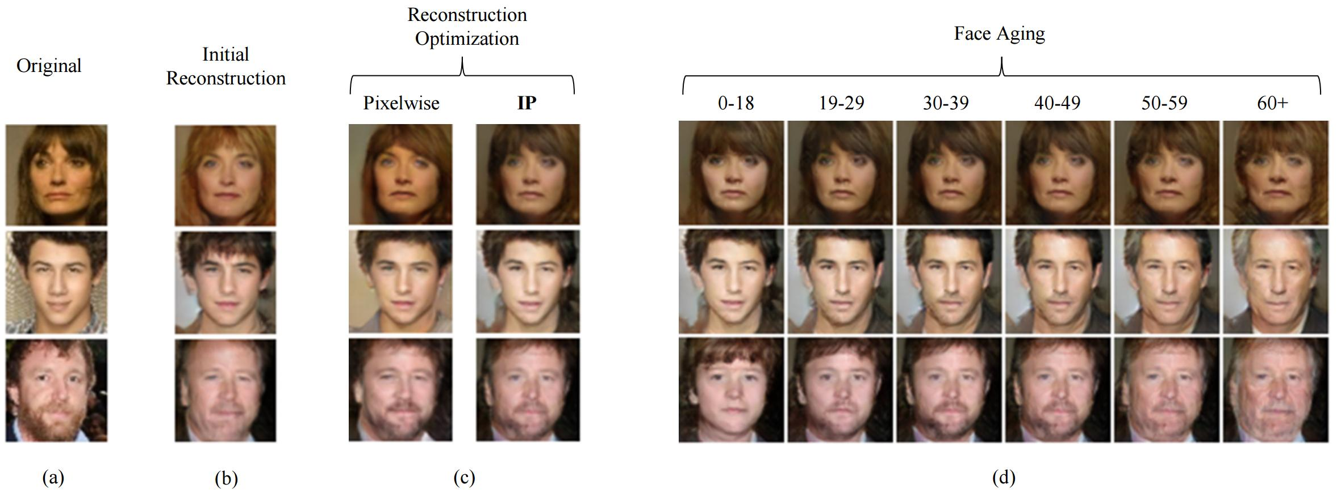
DCGAN approach – application
GAN Auto-encoder/ image embedding
Nice graph of CNN representing the Generator and Disciminator
https://devblogs.nvidia.com/parallelforall/photo-editing-generative-adversarial-networks-2/
Specific application :
Age Conditionnal GAN
Read also
https://www.theverge.com/2017/4/12/15271874/ai-adversarial-images-fooling-attacks-artificial-intelligence
https://arxiv.org/abs/1702.01983v1

Slide 27
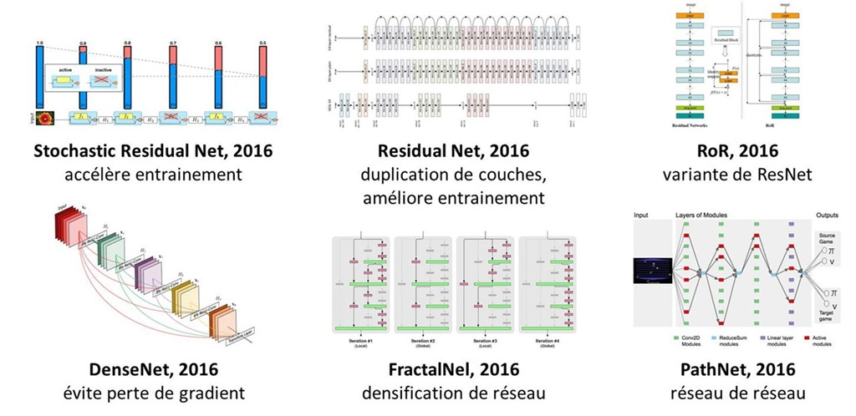
More on the state of the art of Deep Learning & limits of current AI
http://www.oezratty.net/wordpress/2017/douze-mythes-intelligence-artificielle/
%>% right click %>% translate this page with Google translation

Slide 28
Deep learning applications

Slide 29
« This is the year of voice ui 2017 »
https://www.cooper.com/journal/2017/5/this-is-the-year-of-voice-ui

Slide 30
A word on application to health detection of lung cancer AI beats top 4 specialists Enlitics = Jeremy Howard
Have a look at fast.ai

Slide 31
Image recognition
Aipoly : recognizes food
seeingAI : reads text, detect persons, currency, items

Slide 32
Application to text ?

Slide 33
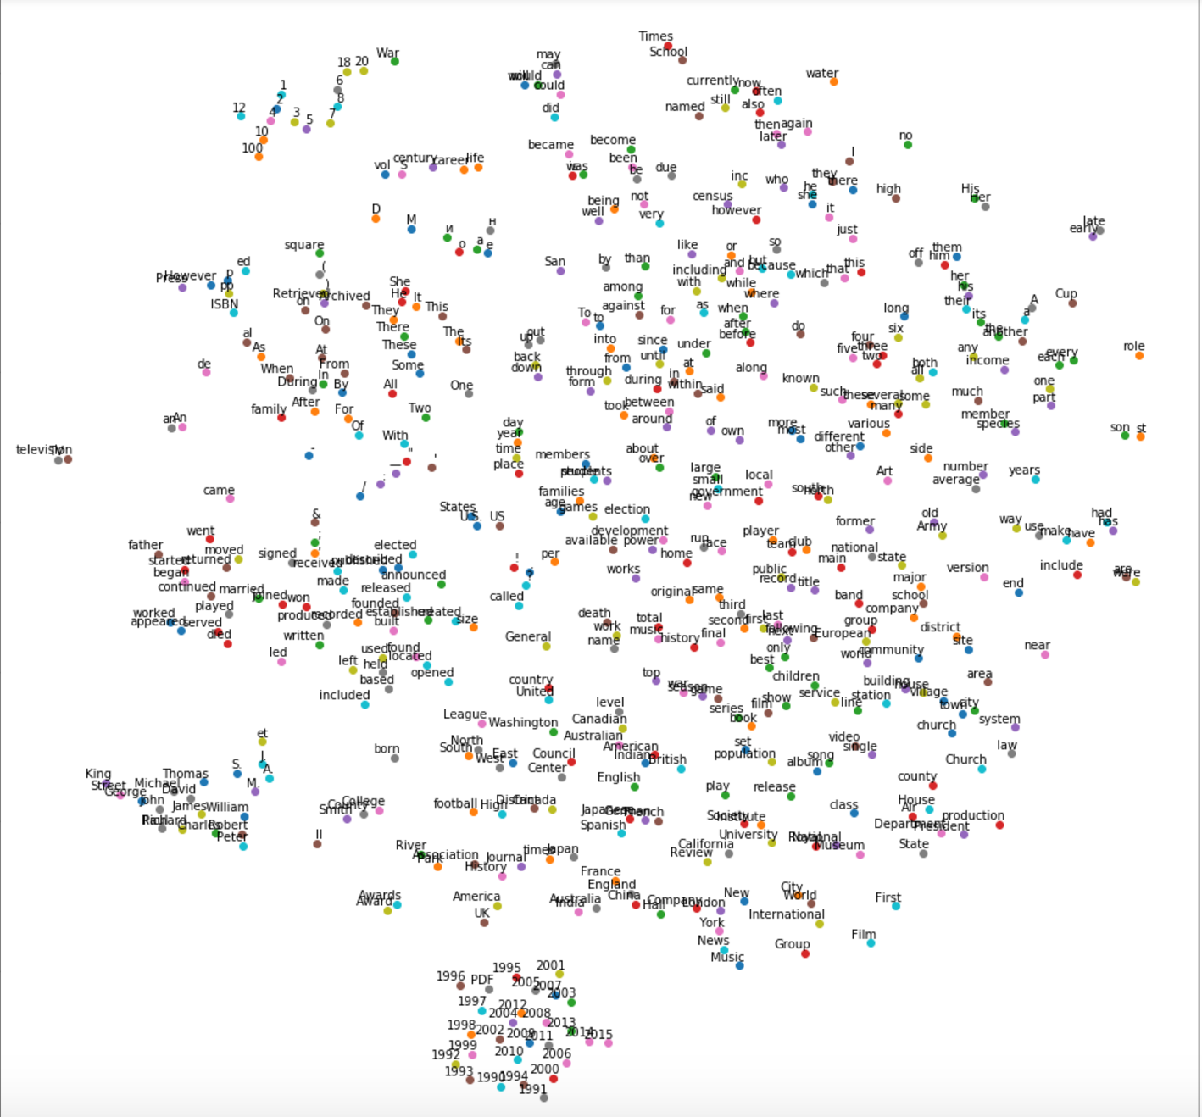
Entity embeddings
Visualization with similar algorithm
After a TSNE
Notes:
To change bullet colors, select the text in question and go to the HOME menu > Bullets and numbers, choose "Custom bullet" and choose the desired bullet.
To insert the bullets to the PowerPoint bullet library, go to menu > Bullets and numbers, choose “bullets and numbering”, choose “picture”, choose import”, select the bullets’ folder previously saved on the hard drive and validate.

Slide 34
Entity embeddings
Visualization with similar algorithm
After a TSNE
Years
Notes:
To change bullet colors, select the text in question and go to the HOME menu > Bullets and numbers, choose "Custom bullet" and choose the desired bullet.
To insert the bullets to the PowerPoint bullet library, go to menu > Bullets and numbers, choose “bullets and numbering”, choose “picture”, choose import”, select the bullets’ folder previously saved on the hard drive and validate.

Slide 35
Entity embeddings
Visualization with similar algorithm
Names
After a TSNE
Notes:
To change bullet colors, select the text in question and go to the HOME menu > Bullets and numbers, choose "Custom bullet" and choose the desired bullet.
To insert the bullets to the PowerPoint bullet library, go to menu > Bullets and numbers, choose “bullets and numbering”, choose “picture”, choose import”, select the bullets’ folder previously saved on the hard drive and validate.

Slide 36
Entity embeddings
Verbs in the past
Visualization with similar algorithm
After a TSNE
Notes:
To change bullet colors, select the text in question and go to the HOME menu > Bullets and numbers, choose "Custom bullet" and choose the desired bullet.
To insert the bullets to the PowerPoint bullet library, go to menu > Bullets and numbers, choose “bullets and numbering”, choose “picture”, choose import”, select the bullets’ folder previously saved on the hard drive and validate.

Slide 37
Entity embeddings
Letters
Visualization with similar algorithm
After a TSNE
Notes:
To change bullet colors, select the text in question and go to the HOME menu > Bullets and numbers, choose "Custom bullet" and choose the desired bullet.
To insert the bullets to the PowerPoint bullet library, go to menu > Bullets and numbers, choose “bullets and numbering”, choose “picture”, choose import”, select the bullets’ folder previously saved on the hard drive and validate.

Slide 38
Entity embeddings
Figures
Visualization with similar algorithm
After a TSNE
Notes:
To change bullet colors, select the text in question and go to the HOME menu > Bullets and numbers, choose "Custom bullet" and choose the desired bullet.
To insert the bullets to the PowerPoint bullet library, go to menu > Bullets and numbers, choose “bullets and numbering”, choose “picture”, choose import”, select the bullets’ folder previously saved on the hard drive and validate.

Slide 39
Entity embeddings
Prepositions
Visualization with similar algorithm
After a TSNE
Notes:
To change bullet colors, select the text in question and go to the HOME menu > Bullets and numbers, choose "Custom bullet" and choose the desired bullet.
To insert the bullets to the PowerPoint bullet library, go to menu > Bullets and numbers, choose “bullets and numbering”, choose “picture”, choose import”, select the bullets’ folder previously saved on the hard drive and validate.

